Slide 1

A Human Skeleton Data Optimization Algorithm For Multi-Kinect
2020 Asia-Pacific Conference on Image Processing, Electronics and Computers (IPEC)

Slide 2
INTRODUCTION
Kinect, released by Microsoft, is a new device that can synchronously acquire RGB images and depth information.
Kinect has some inherent limitations. The measurement range of one Kinect is limited(43◦ in vertical and 57◦ in horizontal, z axis is 1 to 3 meters) and Kinect will be affected by human body occlusion and environment in practical applications, resulting in abnormal and wrong data of 25 human joints, which seriously affects the accuracy and reliability of motion analysis and other calculations.
A data acquisition scheme based on multiple Kinects for data optimization and fusion, taking advantage of the redundancy of multi-view data.
Firstly, we detect and remove the outliers in the human skeleton data, which is the basic of data fusion.
Then we use an adaptive weighted fusion algorithm to fuse each set of skeleton data collected by different Kinect sensors into a stable and valid data sequence to reduce the influence of human body occlusion and improve the robustness and stability of skeleton data.

Slide 3
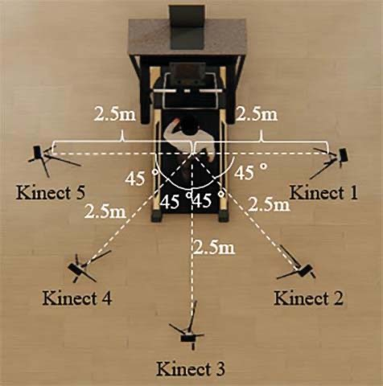
PROBLEM FORMULATION
The subject is asked to walk on a treadmill and five Kinect(More Kinect can be used if the actual environment allows) collected human skeleton data at the same time from different perspectives, which could not only obtain the coordinate sequence of body joints, but also overcome the problem that partial data collected by a single Kinect is invalid.
Deal with the three-dimensional skeleton data of human body from multiple perspectives and obtain a stable and effective data sequence of human joints.
detect outliers(abnormal and wrong skeleton data due to the influence of human body occlusion and measuring environment)
fuse the data obtained by different Kinect(Kinect’s algorithm for detecting human body joints is a trained estimation algorithm essentially, which has inherent measurement error)

Slide 4
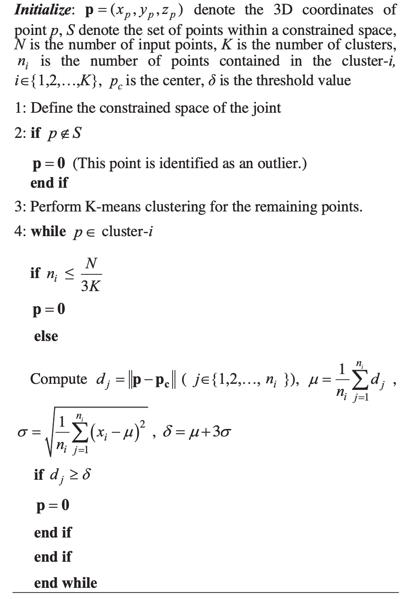
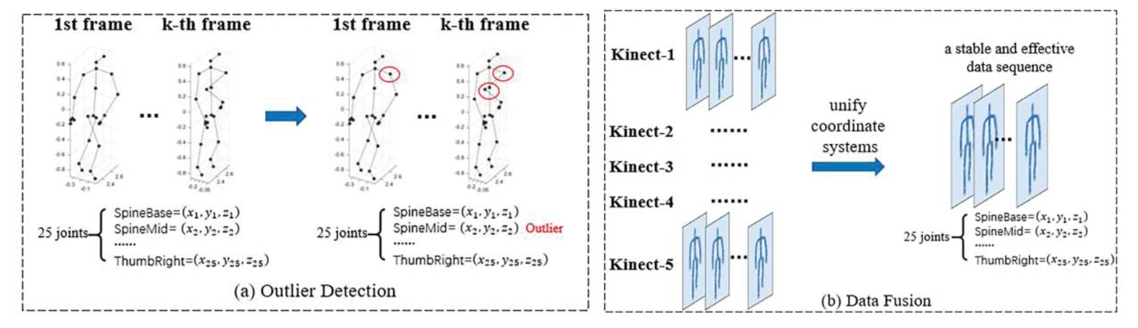
PROBLEM FORMULATION
Algorithm 1 The procedure of outliers detection for the coordinates sequence of each joints.
This paper proposes an outlier detection algorithm based on spatial region constraints and K-means clustering and adopts an adaptive weighted fusion algorithm to fuse the human skeleton data collected by multiple Kinect without any prior knowledge of measurement data.
delta
sigma
拉依达准则

Slide 5
PROBLEM FORMULATION
Outliers Detection for Skeleton Data
Combined with the movement characteristics of subjects in the actual environment and the structure of human skeleton, we first remove part of the outliers by limiting the spatial extent of the body joints.
For example, during normal walking, the joints of the left leg will not appear on the right side of the spine.
We perform K-means clustering on the coordinates of each joints collected by each Kinect instead of all joints.
The reason is that when human body occlusion occurs, the joints detected by Kinect will be close to each other or even superposed, which will cause the outliers of a joint to be recognized as normal points of other joints.
The normal data belongs to the large and dense cluster, while the outlier belongs to the small or sparse cluster or does not belong to any cluster.
After detecting and removing the outliers, we need to unify coordinate systems to implement data fusion.
We adopt the coordinate system transformation algorithm proposed in [19] to convert the 3D coordinates of body joints from different views into Kinect-3’s coordinate system.
[19] 方兴, 曾文宪, 刘经南,等. 三维坐标转换的通用整体最小二乘算法[J]. 测绘学报, 2014, 43(11):1139-1143.

Slide 6
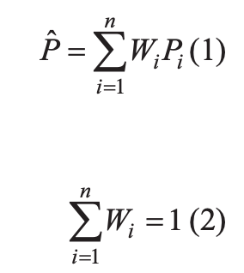
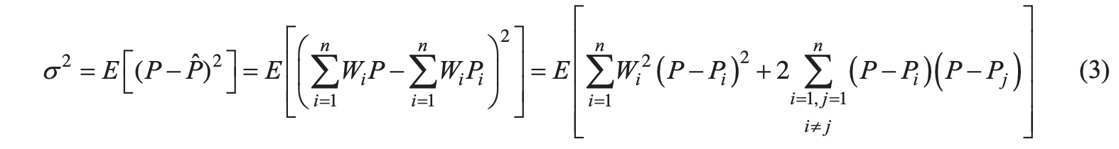
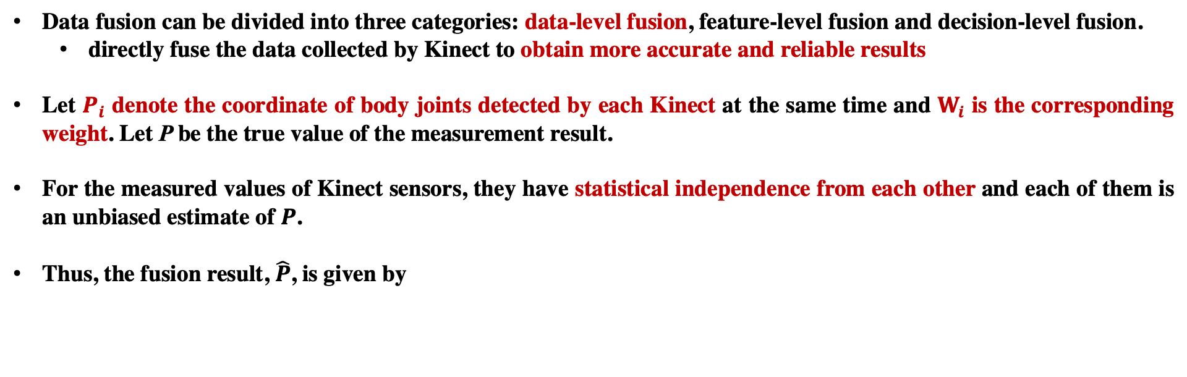
PROBLEM FORMULATION
Data Fusion
Data fusion can be divided into three categories: data-level fusion, feature-level fusion and decision-level fusion.
directly fuse the data collected by Kinect to obtain more accurate and reliable results
Let $P_{i}$ denote the coordinate of body joints detected by each Kinect at the same time and $W_{i}$ is the corresponding weight. Let P be the true value of the measurement result.
For the measured values of Kinect sensors, they have statistical independence from each other and each of them is an unbiased estimate of $P$.
Thus, the fusion result, $\hat{P}$, is given by
无偏估计的意义是：在多次重复下，它们的平均数接近所估计的参数真值。无偏估计常被应用于测验分数统计中。
where $i∈\{1,2,…,n\}$, $n$ is the number of Kinect sensors which is 5 in this paper.
The total variance $σ^{2}$ is

Slide 7

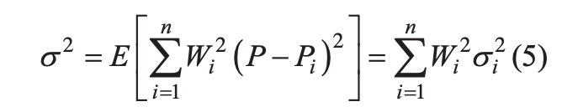
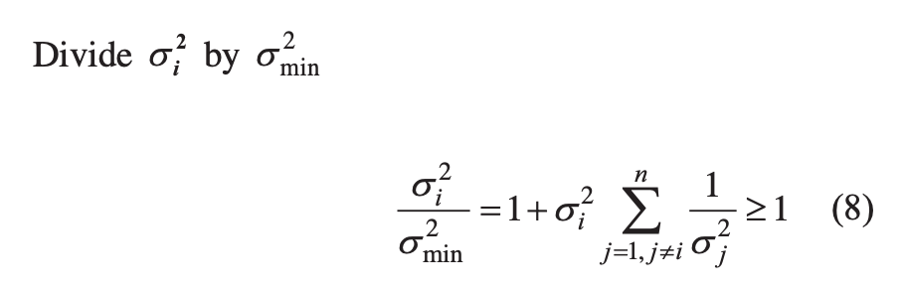
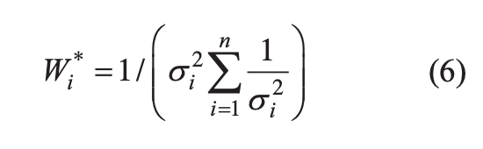
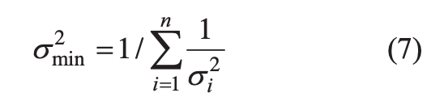
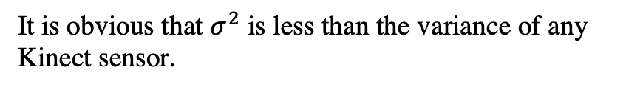
PROBLEM FORMULATION
Data Fusion
where E(P) is the expectation of the variable P. Because $P_{i}$ is an unbiased estimate of $P$, it is easy to figure out
Thus, the total variance is given by
It is easy to see that the total variance is a multivariate quadratic function of the weighting factor and has a minimum value.
According to the extremum theory of multivariate functions, the minimum of the total variance and the optimal weighting factor can be obtained as
It is obvious that $σ^{2}$ is less than the variance of any Kinect sensor.

Slide 8



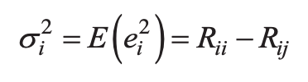
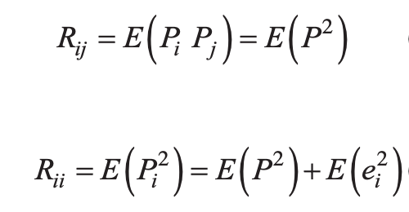

PROBLEM FORMULATION
Data Fusion
To find the optimal weighting factor, we need to figure out the variance of each Kinect.
For the measured values of any two independent Kinect, $P_{i}$ and $P_{j}$, let their measurement errors be $e_{i}$and $e_{j}$.
where $e_{i}$and $e_{j}$ are stationary noise with zero mean value. Thus, the variance of Kinect-i is
We define the correlation factors between $P_{i}$ and $P_{j}$, $R_{ij}$ as ${E(P}_{i}P_{j})$, the autocorrelation factor of $P_{i}$, $R_{ii}$, as $E(P_{i}^{2})$.
Since $e_{i}$, $e_{j}$ and P are uncorrelated variables, we can find
Thus $σ_{i}^{2}$ can be given by

Slide 9
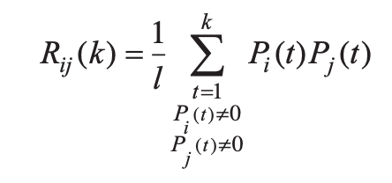
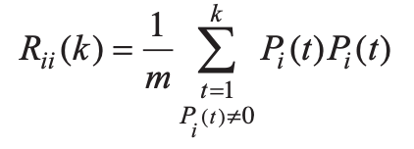
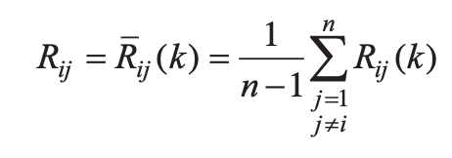
PROBLEM FORMULATION
Data Fusion
$R_{ii}$ and $R_{ij}$ can be obtained by estimating their time domain values.
We take the mean of $R_{ij}\left(k\right)$, $\overline{R_{ij}}\left(k\right)$ as an estimate of $R_{ij}$.
Thus, we get an estimate of the variance of each Kinect using $R_{ii}$and $R_{ij}$.
Sequentially, we can figure out the weight of each Kinect and the fusion result.
Different Kinect sensors can adjust the weight distribution according to the measured values at different moments.
The fusion results have linear unbiased minimum variance.

Slide 10
EXPERIMENTS
Test Cases
Windows 10 computer system using Visual C# and Python language
20 subjects (10 males, 10 females)
Each subject walked on a treadmill for one minute and 1,500 frames of each data sequence were taken for the experiment.
Each frame contains 3D coordinates of 25 body joints from 5 perspectives.
Five Kinect devices started collecting data synchronously.
Results and Analysis
Based on the 3D coordinates of body joints, we calculated the bone length (the Euclidean distance between adjacent joints) and two common gait parameters.

Slide 11
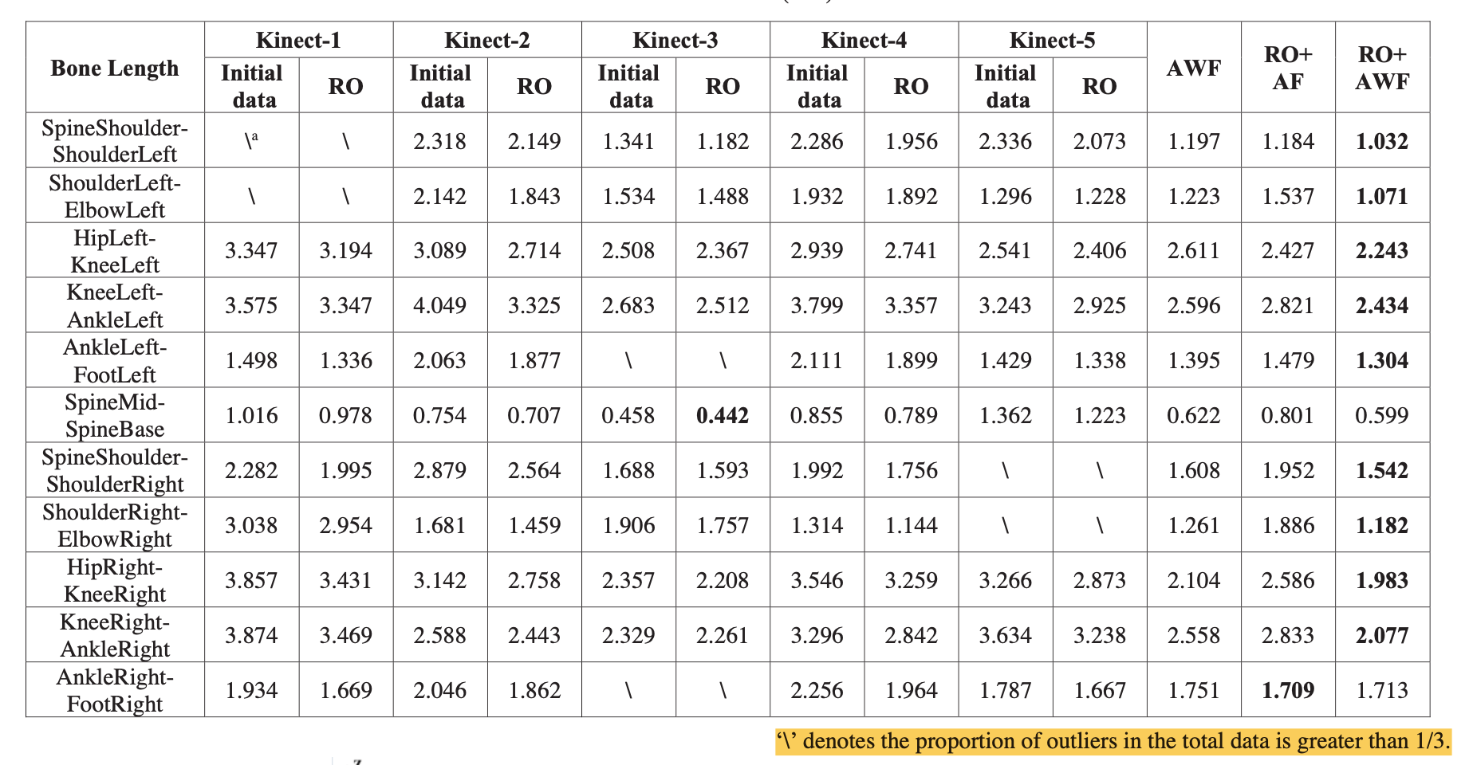
EXPERIMENTS
Initial data
RO: remove outliers from initial data collected by each Kinect;
AWF: adaptive weighted fuse without removing outliers;
RO+AF: remove outliers and average weighted fuse;
RO+AWF: remove outliers and adaptive weighted fuse.
Standard deviation(cm) of bone length

Slide 12
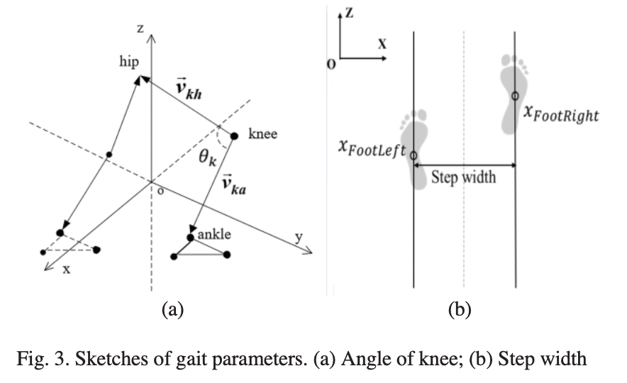
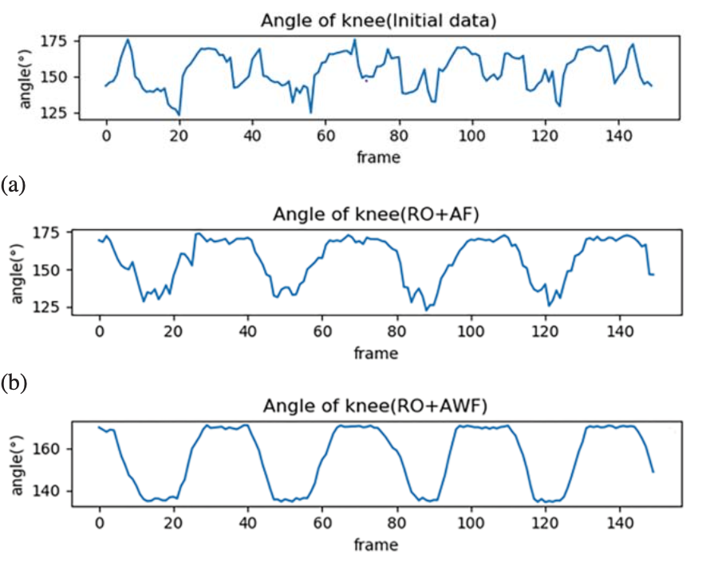
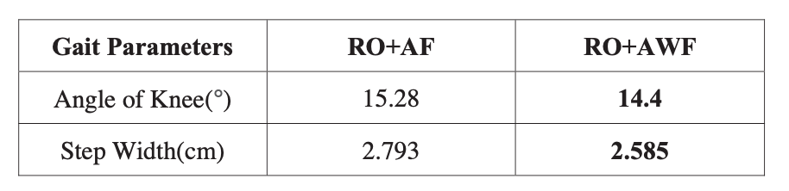
EXPERIMENTS
We calculated gait parameters: angle of knee and step width to further verify the effectiveness of the algorithm.

Slide 13
CONCLUSION
We propose an effective multi-view Kinect skeleton data optimization algorithm in this paper, which can process abnormal and wrong 3D coordinates of 25 human joints caused by measuring environment and human body occlusion.
Outlier detection can improve the effect of data fusion.
The adaptive weighted fusion algorithm can fuse each set of skeleton data collected by different Kinect sensors into a stable and valid data sequence.
This method can improve the stability and validity of skeleton data, and make Kinect more easily applied to motion analysis, motion recognition and medical rehabilitation evaluation.

